Slide 1
RELIGIONS OF THE WORLD
You are to take notes in your binder exactly as they appear here. Please indent in outline form as I have done for you.
*This PowerPoint will be posted to my website.

Slide 2
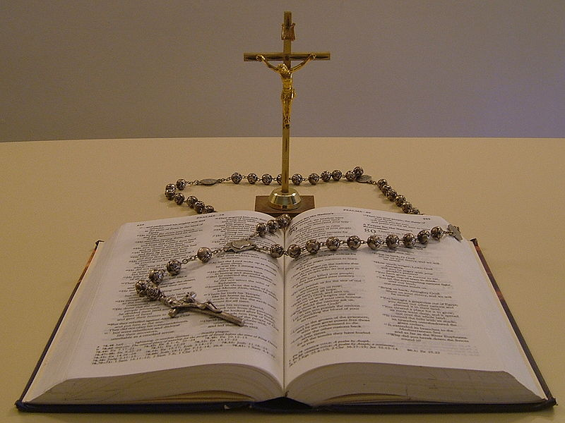
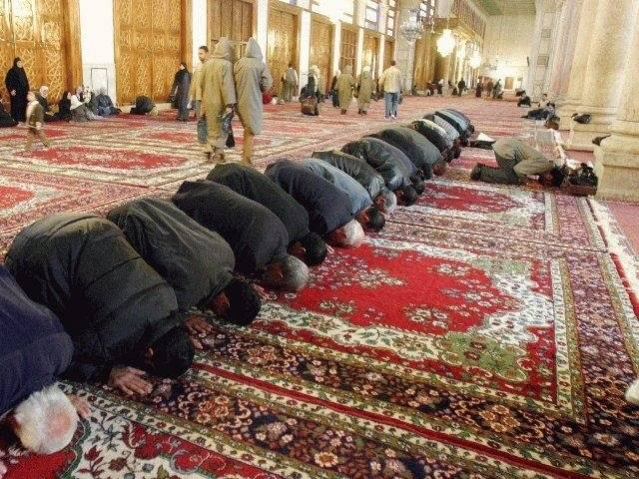
I. WHAT IS RELIGION?
A. religion is a set of common beliefs and practices generally held by a group of people 1. often classified as prayer, ritual, and religious law
2. cultural traditions, writings, history, and mythology, as well as personal faith

Slide 3
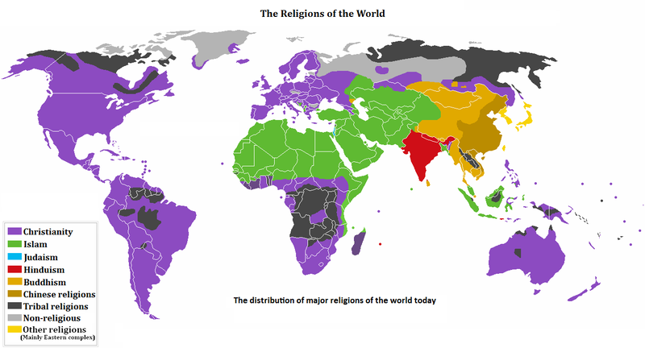

Slide 4
II. Polytheism
A. =the belief in more than 1 God
1. Examples:
a. Hinduism (India)
b. Shinto (Japan)
c. Primal-indigenous

Slide 5
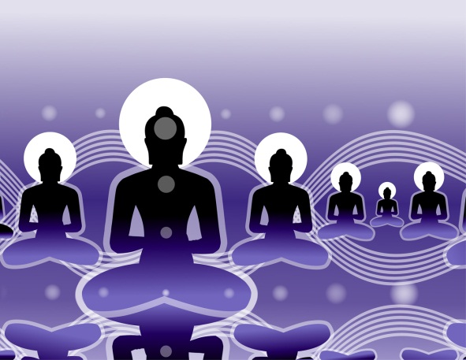


B. Hinduism (1500BC)
1. Basic Beliefs:
a. Many Gods:
i. Brahman #1 God
b. Reincarnation: cycle of rebirth
c. Karma: what goes around?
d. Dharma: duties
e. Vegetarian
f. Yoga

Slide 6
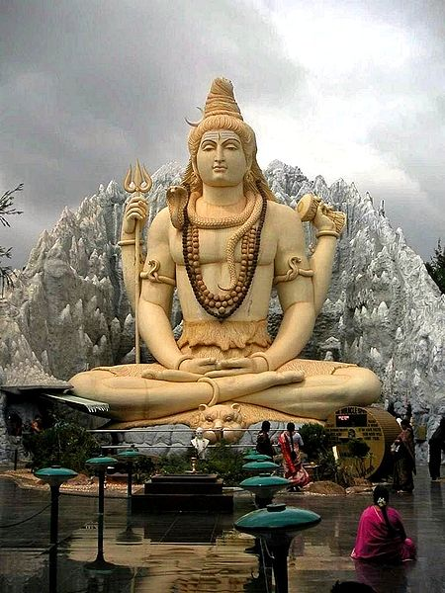
g. Holy Book:
i. the Vedas or epics
h. Temples: place of worship

Slide 7
C. Shinto
1. No founder, 500s AD
2. Basic Beliefs:
a. Many Gods
i. Sun Goddess #1
b. Kami=source of life
c. Respect to all
d. Truthfulness & purification

Slide 8

e. Temples: place of worship
f. Holy Books:
i. Records of Ancient Matters
ii. Chronicles of Japan

Slide 9
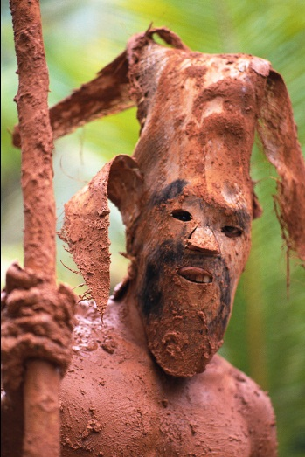

D. Primal-Indigenous (prehistoric)
1. Ancient=no one founder
2. Beliefs:
a. Many Gods
b. Nature & animal Gods/spirits
c. Offerings to Gods
d. Prayers used to communicate with Gods
e. No holy book

Slide 10


III. Monotheism
A. =the belief in only 1 God
1. Christianity (world)
2. Islam (world)
3. Judaism (Israel)
4. Sikhism (India)

Slide 11
IV . The MONOTHEISTIC FAITHS
A. Judaism (came 1st):
Abraham
Isaac Ishmael
=Christians & Jews Muslims

Slide 13
B. Began with Abraham c. 2000BC
1. Believe that God made a covenant* with Abraham
a.=Canaan (Israel) to be the home of “God’s Chosen People”
b. Isaac: Abraham’s son
2. Basic beliefs:
a. 1 God (called Yahweh)
b. Saturday Sabbath
c. Synagogues: house of worship

Slide 14
d. Only Kosher Meat
i. No Pork or venison
-Due to cloven hoof
e. Still waiting for their Messiah* (=savior of man)
f. Men wear yamukahs in synagogue

Slide 15
g. Holy Book:
i. the Torah
•1st 5 books of the Christian Old Testament in Bible
h. Holidays:
i. Hanukkah
ii. Rosh Hashanah
iii. Passover
i. Rabbi: priest

Slide 16
B. Christianity (began with Jesus Christ)
in 1st century AD
1. Basic beliefs: (Isaac also)
a. 1 God
b. Jesus as the Messiah*
c. the Trinity (Father, Son, Holy Spirit)
d. Sunday Sabbath
e. Church: place of worship

Slide 17
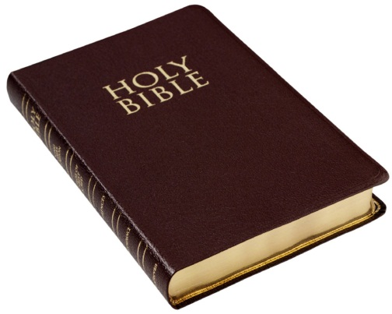

f. Holy Book: the Bible
i. Old & New Testament
g. Forgiveness of sins
h. Holidays:
i. Christmas
ii. Easter
i. Priests, ministers, reverends
j. All people equal
k. Sacraments: baptism, marriage, communion, last rites

Slide 18
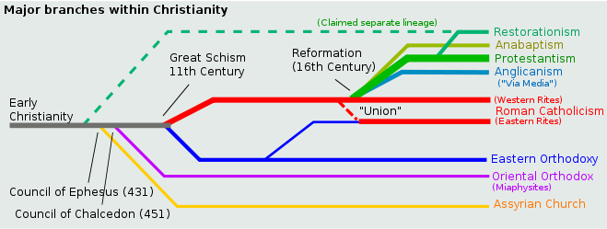
l. Many different types: i. Catholic ii. Protestant: Lutheran, Baptist, Methodist, Episcopalian, etc. iii. Orthodox: Greek & Russian

Slide 19
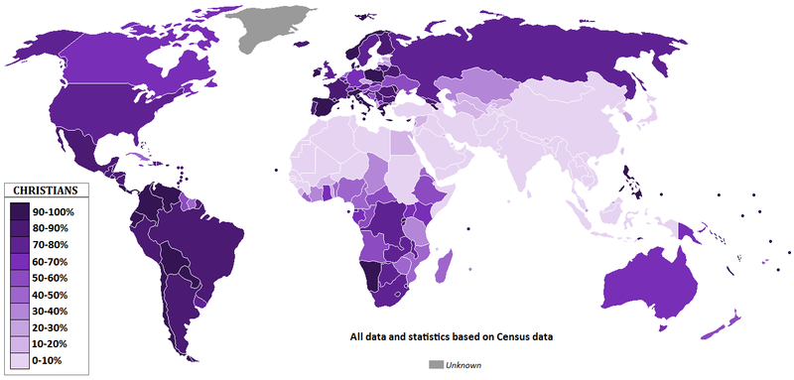

Slide 20
C. Islam (followers called Muslims)
1. Began with Mohammed (632AD)
2. Basic beliefs: (Ishmael)
a. 1 God (called Allah)
b. Mohammed NOT Messiah but messenger of God
c. Friday Sabbath
d. 5 Pillars of Islam guide life

Slide 21

e. Holy book: the Koran (written only in Arabic)
f. Mosque: place of worship
g. Holidays:
i. Ramadan
h. Imams: (aka priests)
i. Different types: Sunni & Shiite
j. No Pork or Venison (cloven hoof)
k. Mecca: holiest city, birthplace of Mohammed

Slide 22
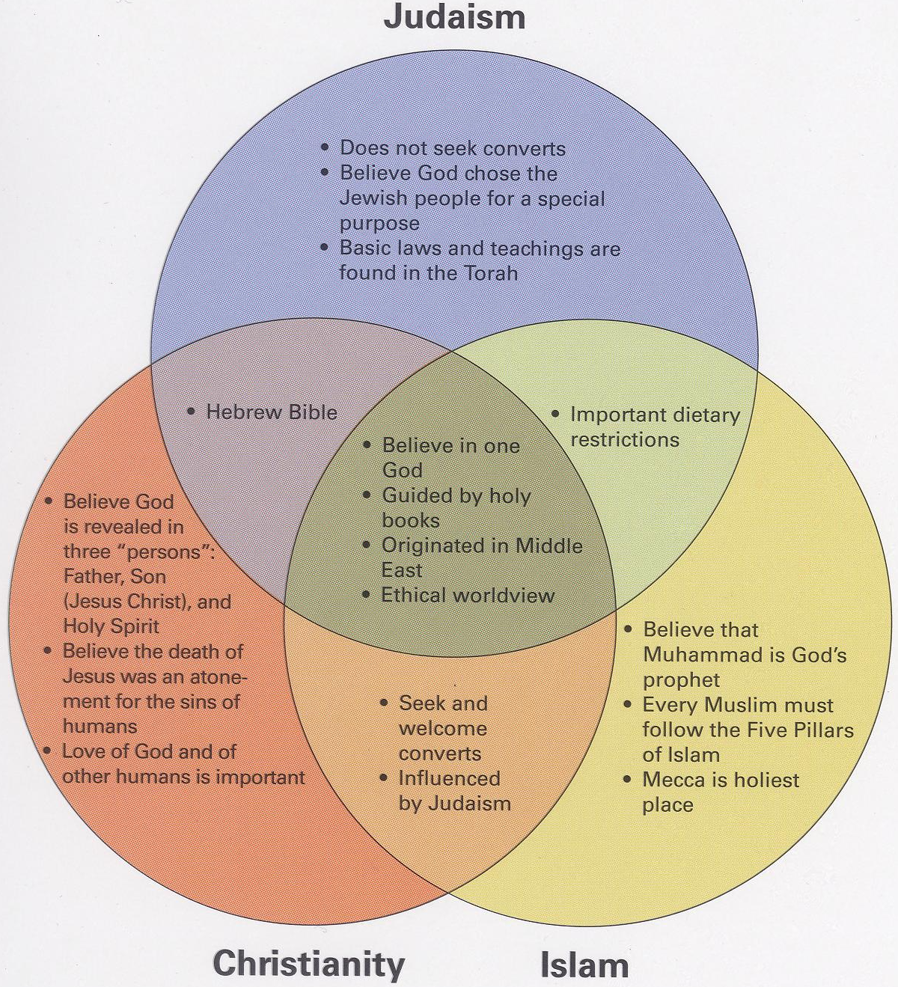
The Three monotheistic religions
Judaism, Christianity and Islam all share many similarities.
Judaism is the root religion for all three.

Slide 23
D. Sikhism
1. Combines Hindu & Islam
2. Begun by Nanuk 1500sAD
3. Basic Beliefs:
a. 1 God
b. Reincarnation
c. Karma
d. All humans equal
e. Meditation
f. Holy Book: 1st Book
g. Temple: place of worship
h. Men never cut hair

Slide 24
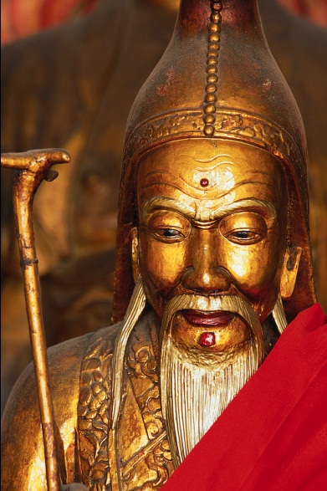
V. Belief Systems, NOT a Religion
A. Confucianism
1. Created by Confucius (Kong Fuzi around 500BC)
2. Basic Beliefs:
a. No Gods
b. NOT a religion but a system of conduct in life
c. Yin & Yang

Slide 25
d. Filial Piety:
i. Honoring ancestors
ii. Obeying elders
e. the 5 Relationships:
i. ruler to ruled
ii. father to child
iii. husband to wife
iv. Elder brother to younger brother v. friend to friend

Slide 26
f. Civil Service Exams
(500BC—1900AD)
i. Anyone could take the tests to get a better job in the government
g. Writings:
i. The Analects
ii. The 5 Classics

Slide 27

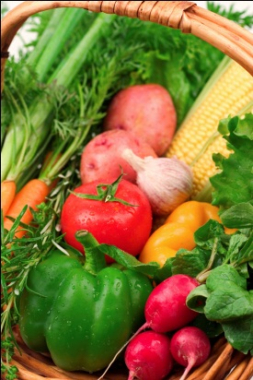
B. Traditional Chinese (Daoism)
1. No founder, 900s AD
2. Beliefs:
a. Not a religion but a way of life
b. Reincarnation
c. Live a virtuous life (do right thing)
d. Harmony with nature
i. many are vegetarian

Slide 28
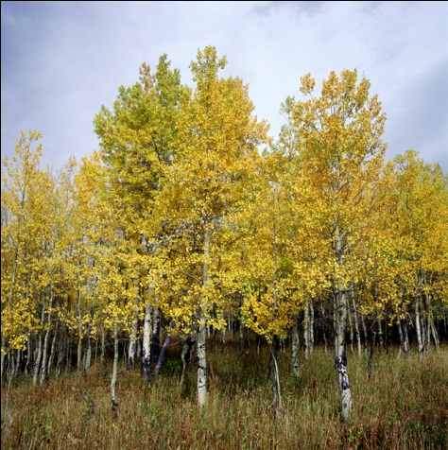
e. Many Confucian beliefs:
1. the 5 Relationships
2. Filial Piety
3. Yin & Yang
4. Civil Service Exams
f. Writings:
1. Dao de Jin (The Way of Power)
2. Zhuangzi

Slide 29
C. Buddhism (after Hinduism in 4thc. BC)
1. Begun by Siddartha Guatama
(the Buddha) as alternative to Hinduism=many of same beliefs
2. Basic Beliefs:
a. No Gods
b. Goal in life: to achieve Nirvana
c. Karma
d. Reincarnation
e. Vegetarian
f. Yoga

Slide 30

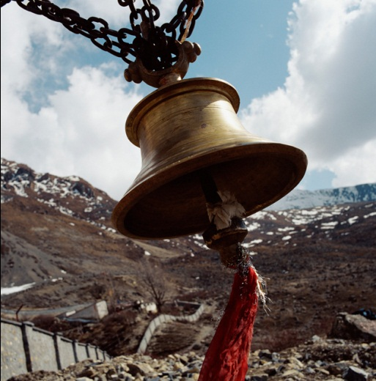
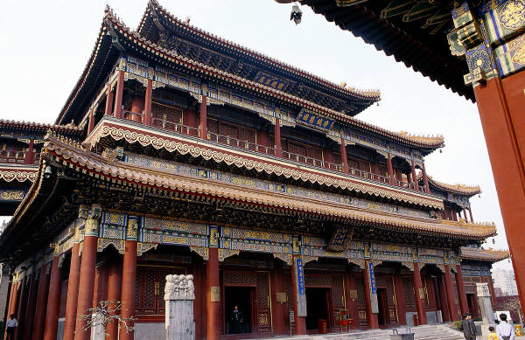
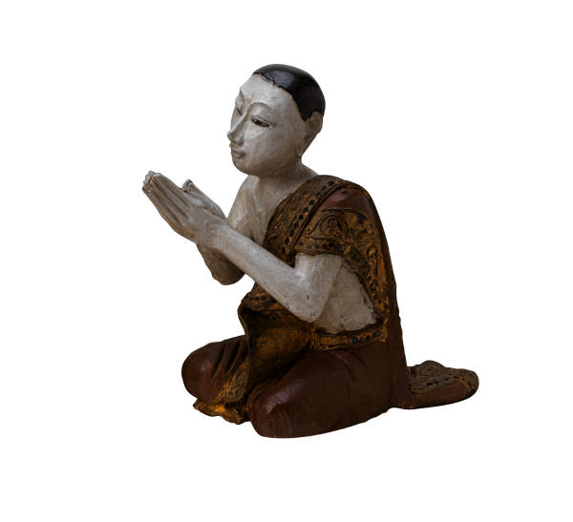
g. Enlightened Ones: Buddhas
h. 8 Fold Path: guides life
i. Holy Books:
•4 Noble Truths
•Tripitaka (3 Baskets)
j. Temples: places of worship

Slide 31
TEST on Religions will be included in the Greece & Rome unit next week!

